Slide 1
Wearable BLE Heart Monitor PIFA Antenna
Team 4: Craig Vonderheide, Hayden Michel, Isaac Feeny, Mika Kretzmann-Clough, Sasha Strauss

Slide 2
Assumptions and Heart Monitor Considerations
We are designing a PIFA antenna to transmit data from a wearable heart monitor using BLE.
We are assuming that there is a strong input signal which can be efficiently transmitted by the PIFA antenna.
We are assuming the antenna will be mounted on the wearable device itself rather than directly on the human body, so factors due to skin and the rest of the body were not considered.
We are assuming the wearable itself will have minimal impact on antenna performance.
The PIFA antenna we are using will have a ground plane and shield the body from most of the radiation. Additionally, BLE is intentionally lower power so there shouldn't be any safety concerns due to this antenna.

Slide 3

Bluetooth Low Energy (BLE) Basics
BLE allows for data transfer similar to Bluetooth while using less power. This is accomplished by sending data in short bursts rather than constantly keeping communication open like normal Bluetooth.
BLE is ideal for this project's use case as a wearable heart monitor should be light and not have a large battery, so minimal power consumption is ideal. Additionally, for heart monitoring constant communication is not necessary, the heart data can be sent in packets instead of constantly, so use of BLE is logical.
Notes:
BLE vs Bluetooth: Bluetooth's constant communication is better for streaming music from your phone to your headphones, but this incurs higher power costs. An effective use for BLE would be a sensor that sends out information once every few seconds so keeping communication open is unnecessary.
Additionally, BLE is easily integrated with smart phones and other wireless applications allowing for easy integration of the antenna into a larger system.

Slide 4

BLE Protocol
BLE Data Transfer Technique​:
    Frequency Band: 2.4 GHz​
    40 2 MHz channels​
    Data Rate: <2 Mbps​
    Communication Range: <400 m​
    Power Consumption: <20 mA​
    Technical Standard: IEEE 802.15.1​
Power density limit is 10 by the FCC 40 by the ICNIRP.
Peak SAR limit is 1.6 by the FCC and 2 by the ICNIRP.
RF identification (RFID) and near-field communication (NFC) inherently combine wireless communication and power delivery within a single system.
BLE Protocols:
  Data Rate: Low-Moderate
  Communication Range: Moderate
  Power Consumption: Moderate

Slide 5
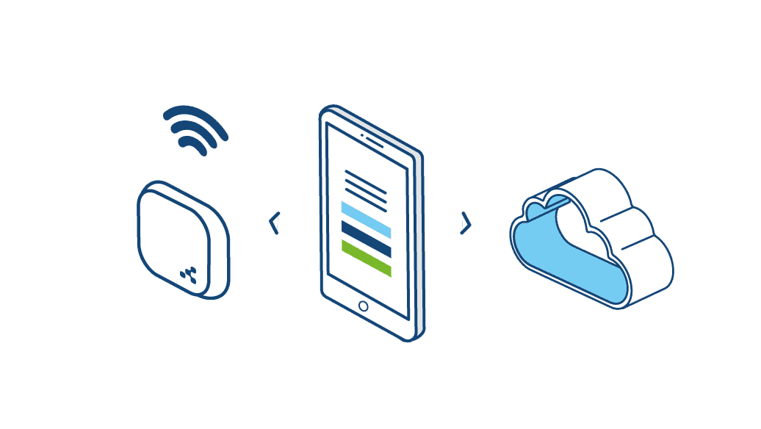
Bluetooth Low Energy (BLE)
BLE radio devices conserve power by turning on when necessary.
With only three channels available to establish a connection between devices, BLE consumes less energy and connects faster.
Primary advertising channels are used to find devices/send signals.
BLE devices have a longer battery lifespan due to the use of periodic short bursts to transmit data and battery recovery during idle periods.
BLE Protocol uses an asymmetric design:
  One central device that uses more power and has more processing capability.
  Peripheral that has less capabilities and limited energy resources.

Slide 6
BLE Protocol Stack
Physical Layer (PHY)
Outlines requirements for hardware (LE radio) used in data transmission and reception over the air.
Link Layer
In charge of setting up LE radio to create communication links according to the kind of communication.
Host Controller Interface (HCI) Layer
Serves as an interface between host's higher-level protocols and controller's lower-level protocols.
Logical Link Control & Adaptation Protocol Layer (L2CAP)
Facilitates communication between BLE stack's top and bottom layers.

Slide 7
BLE Protocol Stack
Security Manager (SM)
Outlines how LE devices are paired, authenticated, and encrypted.
Guards against tracking, Man-in-the-Middle attacks, and passive eavesdropping.
Attribute Protocol (ATT)
Data type known as an attribute is used by LE devices to store data.
An attribute's structure and access permissions (read, write, read-only, etc.) are specified by the ATT.
Generic Attribute Profile (GATT)
Offers a file-folder-based hierarchical data structure.
Generic Access Profile (GAP)
Outlines how a BLE device can connect or broadcast to other devices.

Slide 8
Design of Wireless-Enabled Wearable Devices
Faster data transfer and broader coverage come at the cost of power consumption.
Applications that require frequent data transmission require rapid low-latency communication.
Devices that only transmit data periodically can function with slower speeds.
Long-range communication provides greater mobility but requires more energy.
Many wearable electronics communicate primarily with nearby devices.
Overlap of frequency bands causes interference.
Results in distorted signals, data loss, or increased latency

Slide 9
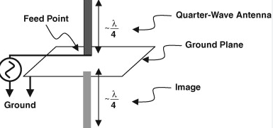
Monopole Antennas
Monopoles can be seen as half of a dipole that sits above the ground plane.
The current distribution is like that of a dipole, while the terminal voltage is about half.
The directivity of the monopole is approximately twice that of a dipole.
While monopoles require a λ/4 electrical length, their physical size is often too big for compact devices
PIFAs are a type of monopole that can be implemented for smaller wireless systems and wearables.

Slide 10
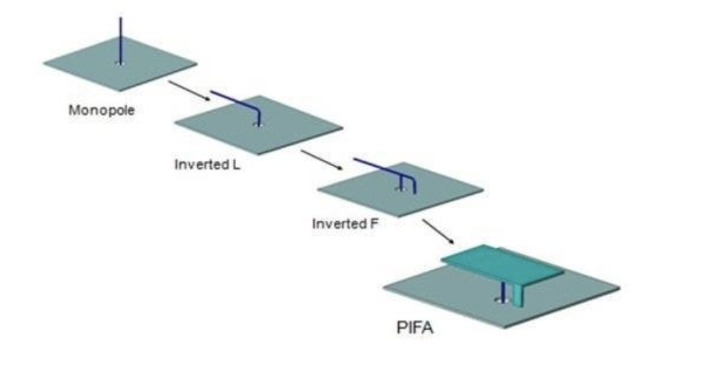
PIFA (Planar Inverted F Antenna) Basics
Compact planar monopole antenna.
Formed by folding the quarter wavelength monopole.
Shaped like an "F" due to the feed and shorting pin.
Common applications include phones, Bluetooth devices, and Wi-fi routers.

Slide 11
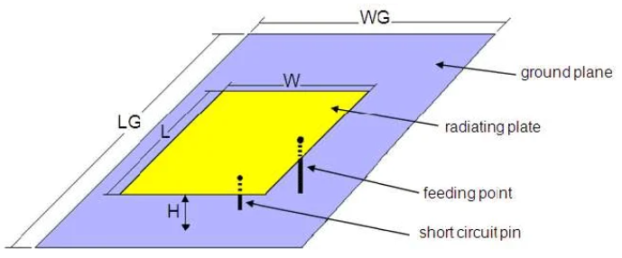
PIFA Structure
Radiating patch on top
Ground plane that acts as reference
Shortening pins connecting to ground
A Feed point
Substrate

Slide 12
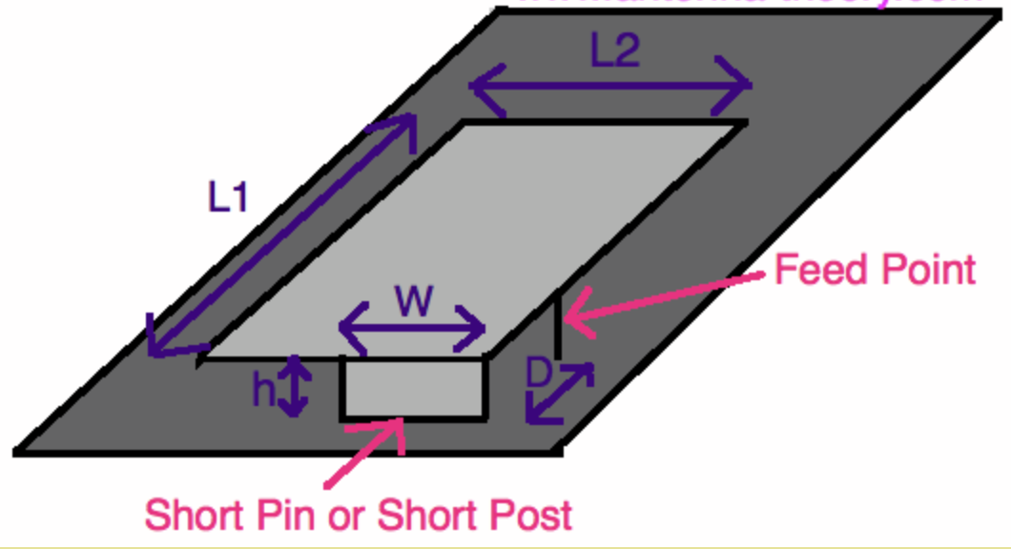
PIFA Operation
Electrical Length is approximately a quarter wavelength
  L1 + L2 = λ/4
Feed- short distance controls impedance
  Closer → Lower
  Further → Higher
Naturally close to 50 Ohms matching
No external matching needed usually
Radiation pattern is close to omnidirectional

Slide 13
How Different PIFA Dimensions Affect BW / Frequency
Increasing electrical length lowers resonant frequency, while increased spacing improves bandwidth.
Dimension | BW | Frequency
H | Increases | Decreases
W | Increases | Increases
L1 | Increases Slightly | Decreases
Feed Plate Width | Increases | Increases
L2 | Increases Slightly | Decreases
D | Increases | Decreases Slightly

Slide 14
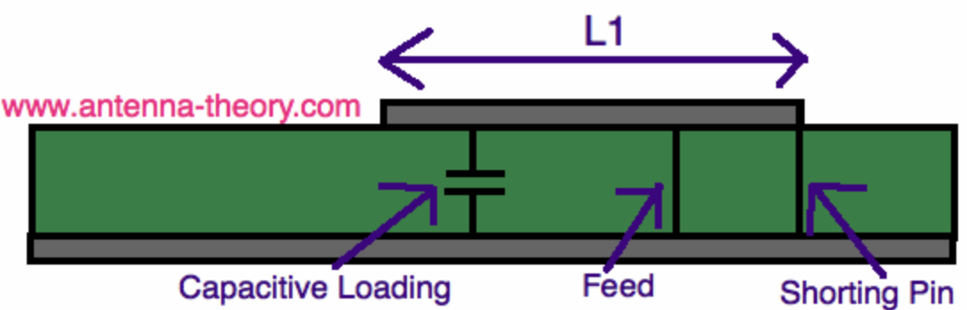
Capacitive loading to reduce PIFA size
Add a capacitor from the plate to ground
Increases the antenna's electrical length
Lowers the resonant frequency without changing the size
Allows for the PIFA to be made smaller for the same bandwidth

Slide 15
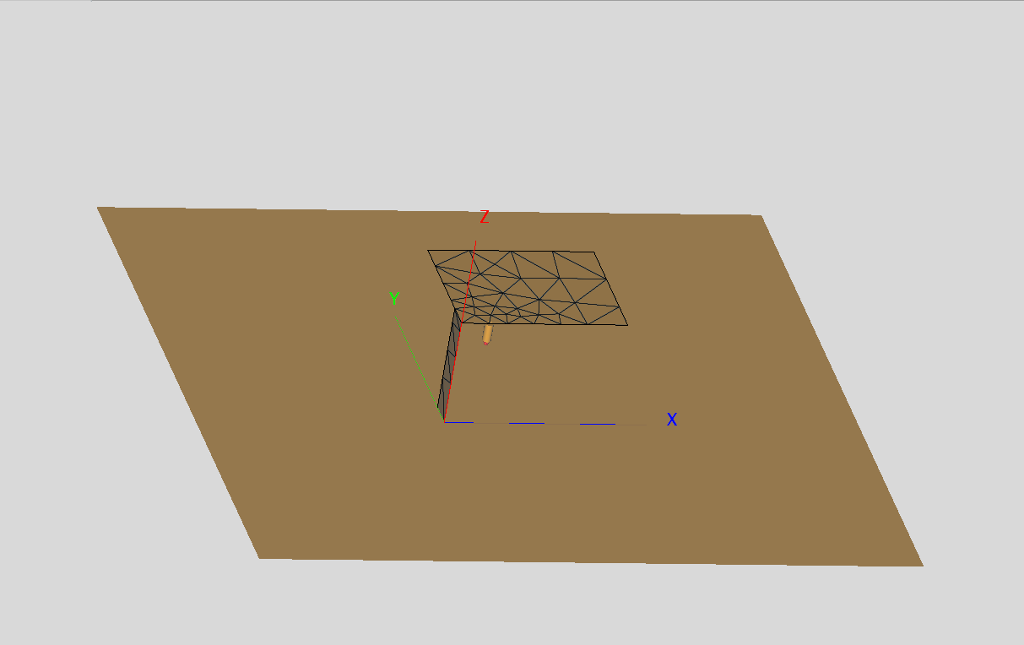
Initial Design
Infinite PEC ground-plane
Mismatched L2 and W
Feed port with a wire on the right edge
H quite tall and arbitrary

Slide 16
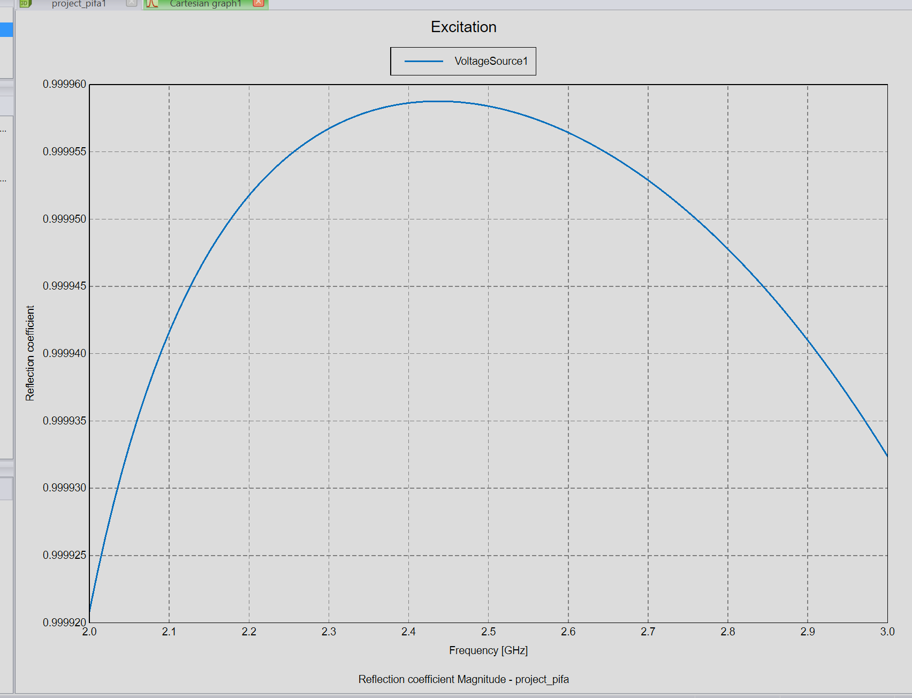
Initial Sim Results-Reflection Coefficient
Matching was quite bad
Tried for many combinations of L1/L2
Tried different feed distancing
Still a very bad design

Slide 17
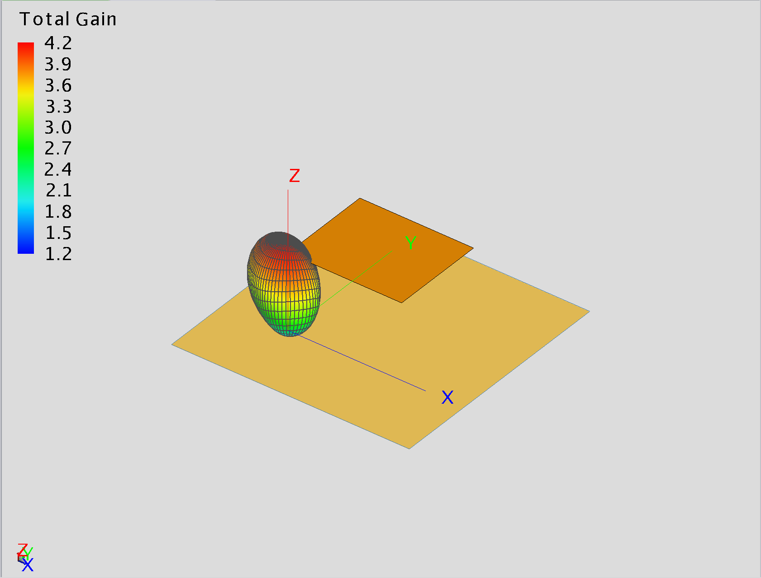
Initial Sim Results-
3D Gain Pattern
Pattern was very directive when should be approximately isotropic
Gain was low even at maximum and quite low outside of the peak.

Slide 18
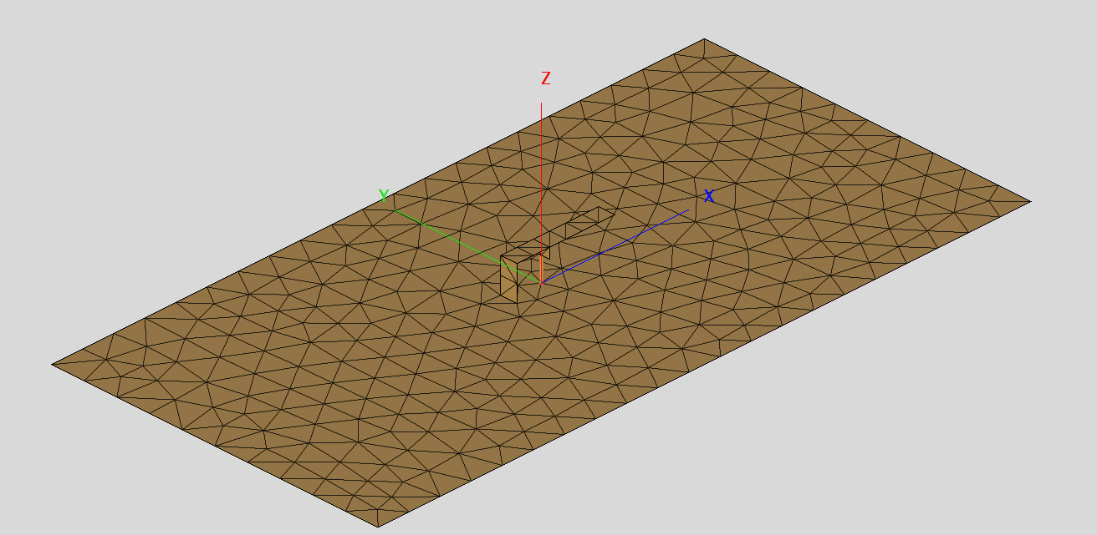
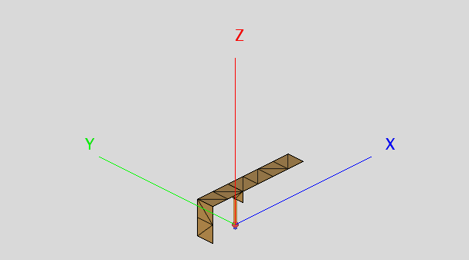
Second Design
Finite(but large) PEC ground plane​
Matched L2 and W
Fed by W width strip with wire, centered along the antenna
Starting point for design was L1 + h = λ/4

Slide 19
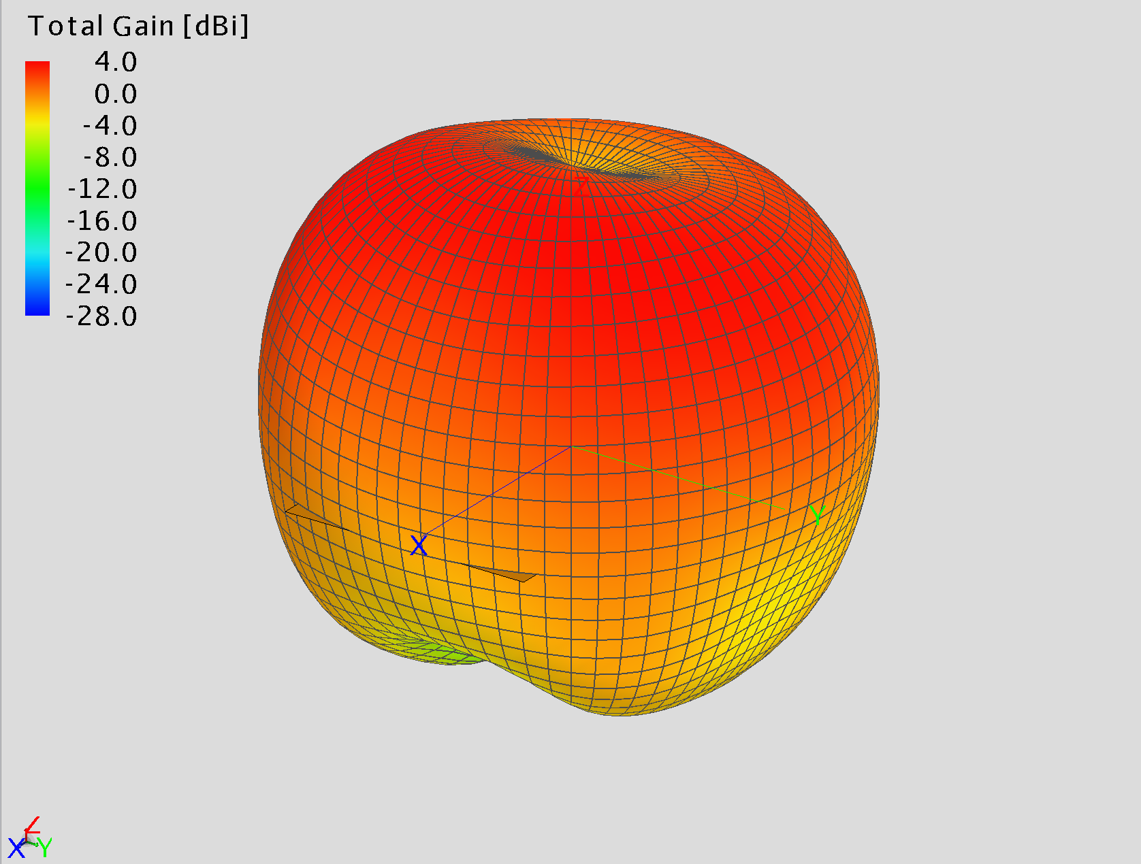
Final Sim Results -
3D Gain Pattern
Pattern is quite isotropic, especially in the directions we care about for this application.
Much lower gain towards chest, which is desirable both for safety and performance.

Slide 20
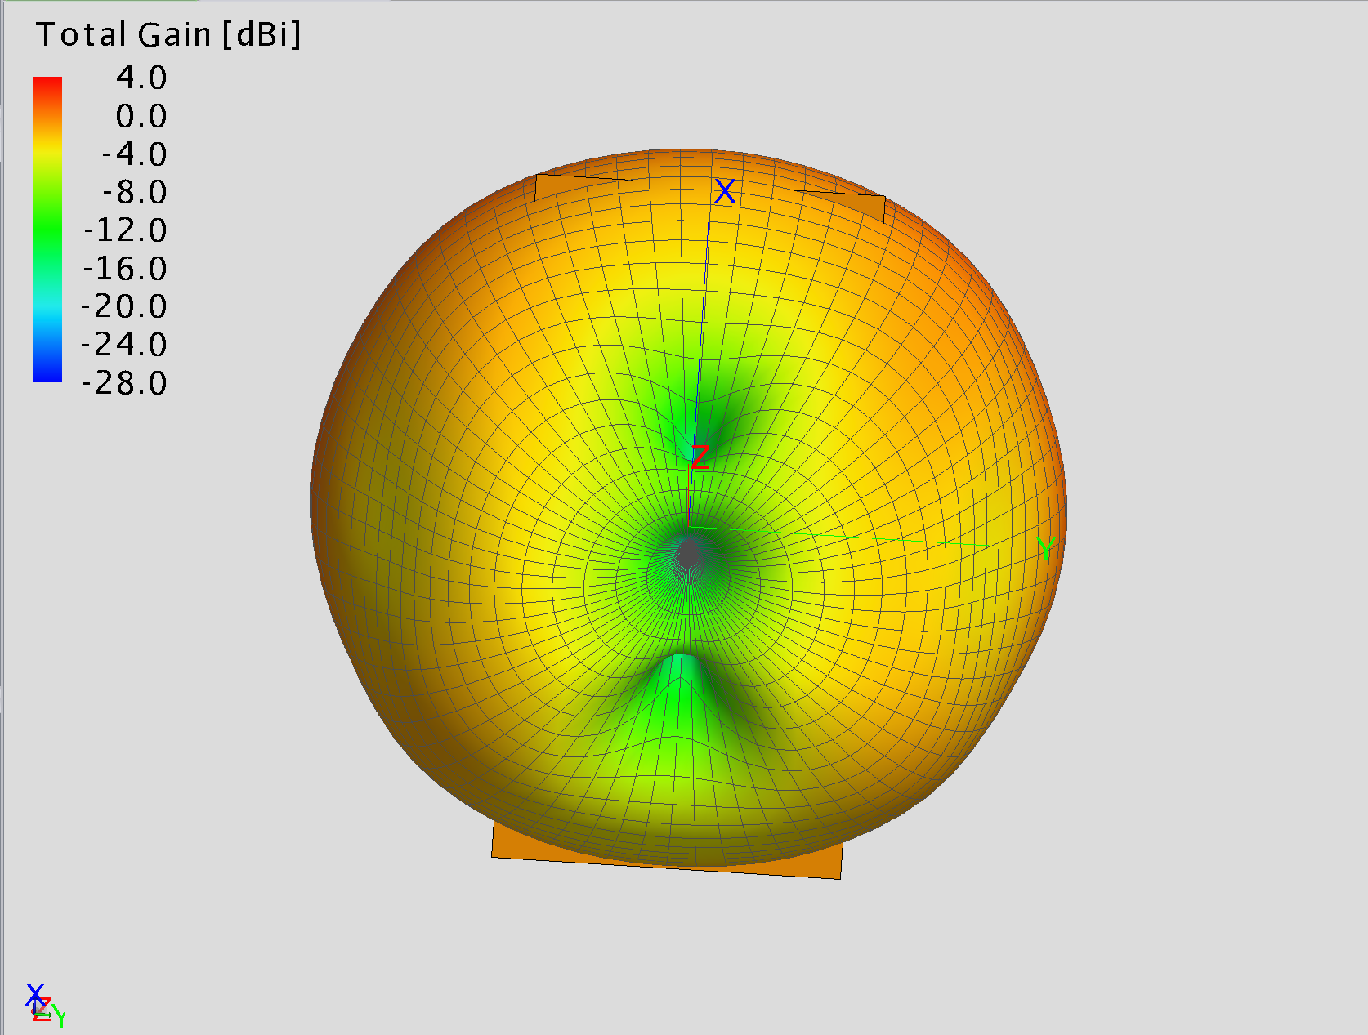
Final Sim Results -
3D Gain Pattern, Underside
Pattern is quite isotropic, especially in the directions we care about for this application.
Much lower gain towards chest, which is desirable both for safety and performance

Slide 21
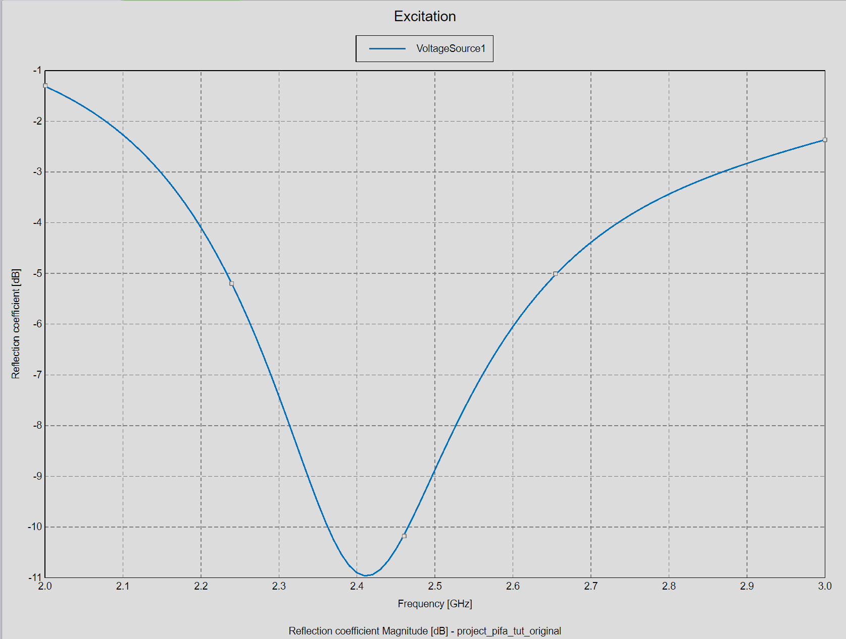
Final Sim Results -
Reflection Coefficient​
Resonant at our intended 2.4 GHz, but has enough –10 dB bandwidth to accommodate the 40* 2Mhz channels as well.
To move resonant frequency swept over L1 and h
To improve matching ran many sweeps over D and "gap"

Slide 22
Final Values
L1 = 30e-3​
L2 = W = 5e-3
D = 10e-3
H = 10e-3
"Gap" = 7e-3

Slide 23

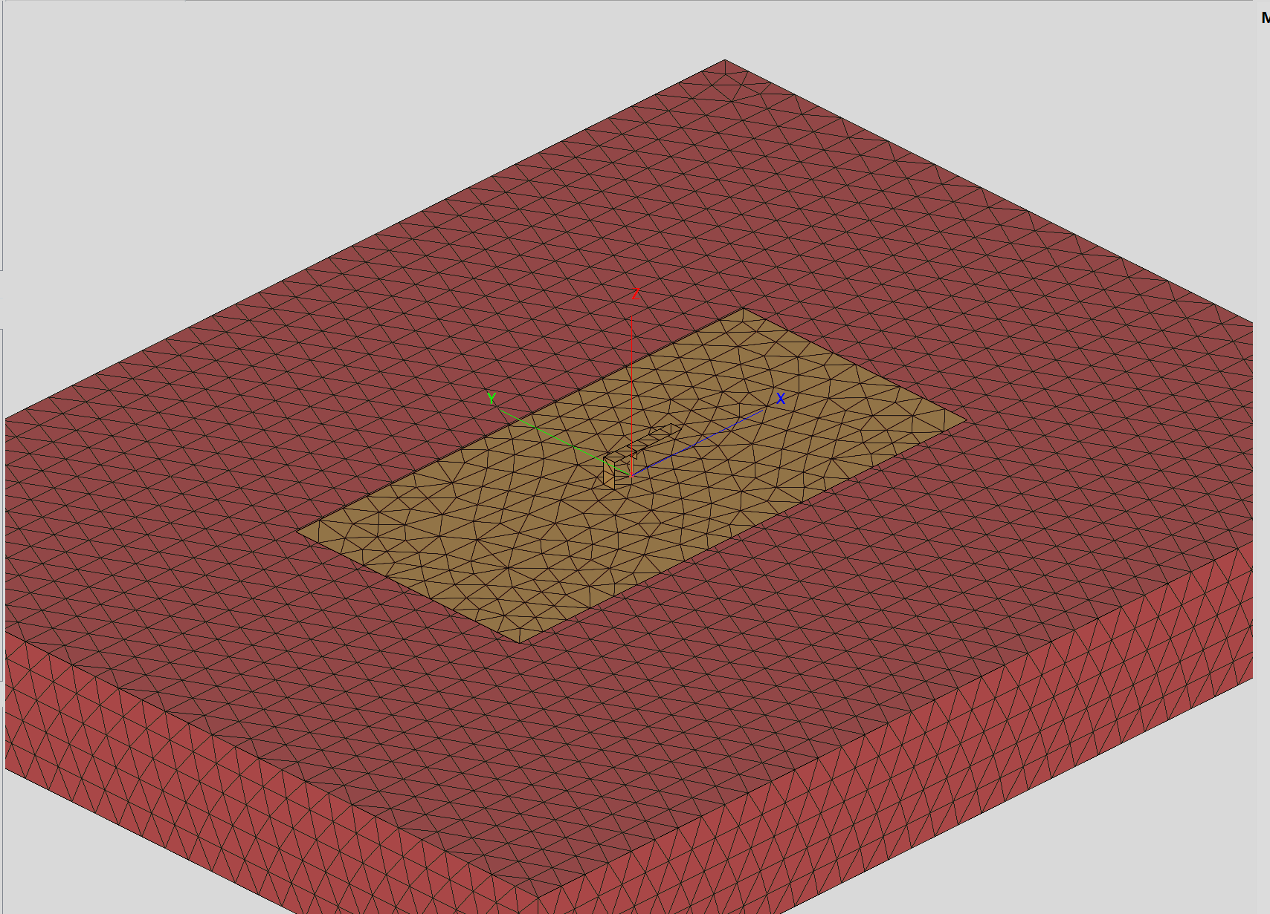
Modeling Tissue
This antenna will be placed in close proximity to the body, so modeling its electric properties is important.
Theres a database of electric properties of various tissue, so I modeled the chest as a solid block of muscle at 2.4 GHz

Slide 24
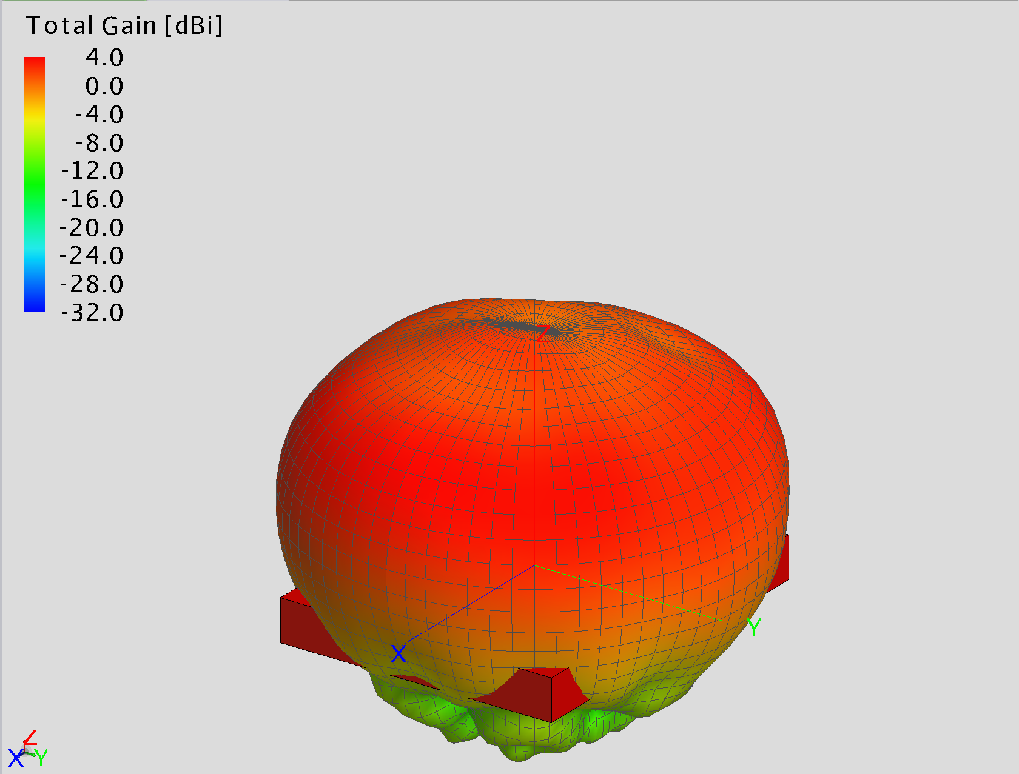
Muscle Sim Results -
3D Gain Pattern
Pattern is still quite isotropic in relevant directions
I would expect this dielectric to reduce performance so it is curious that it appears to not be.

Slide 25
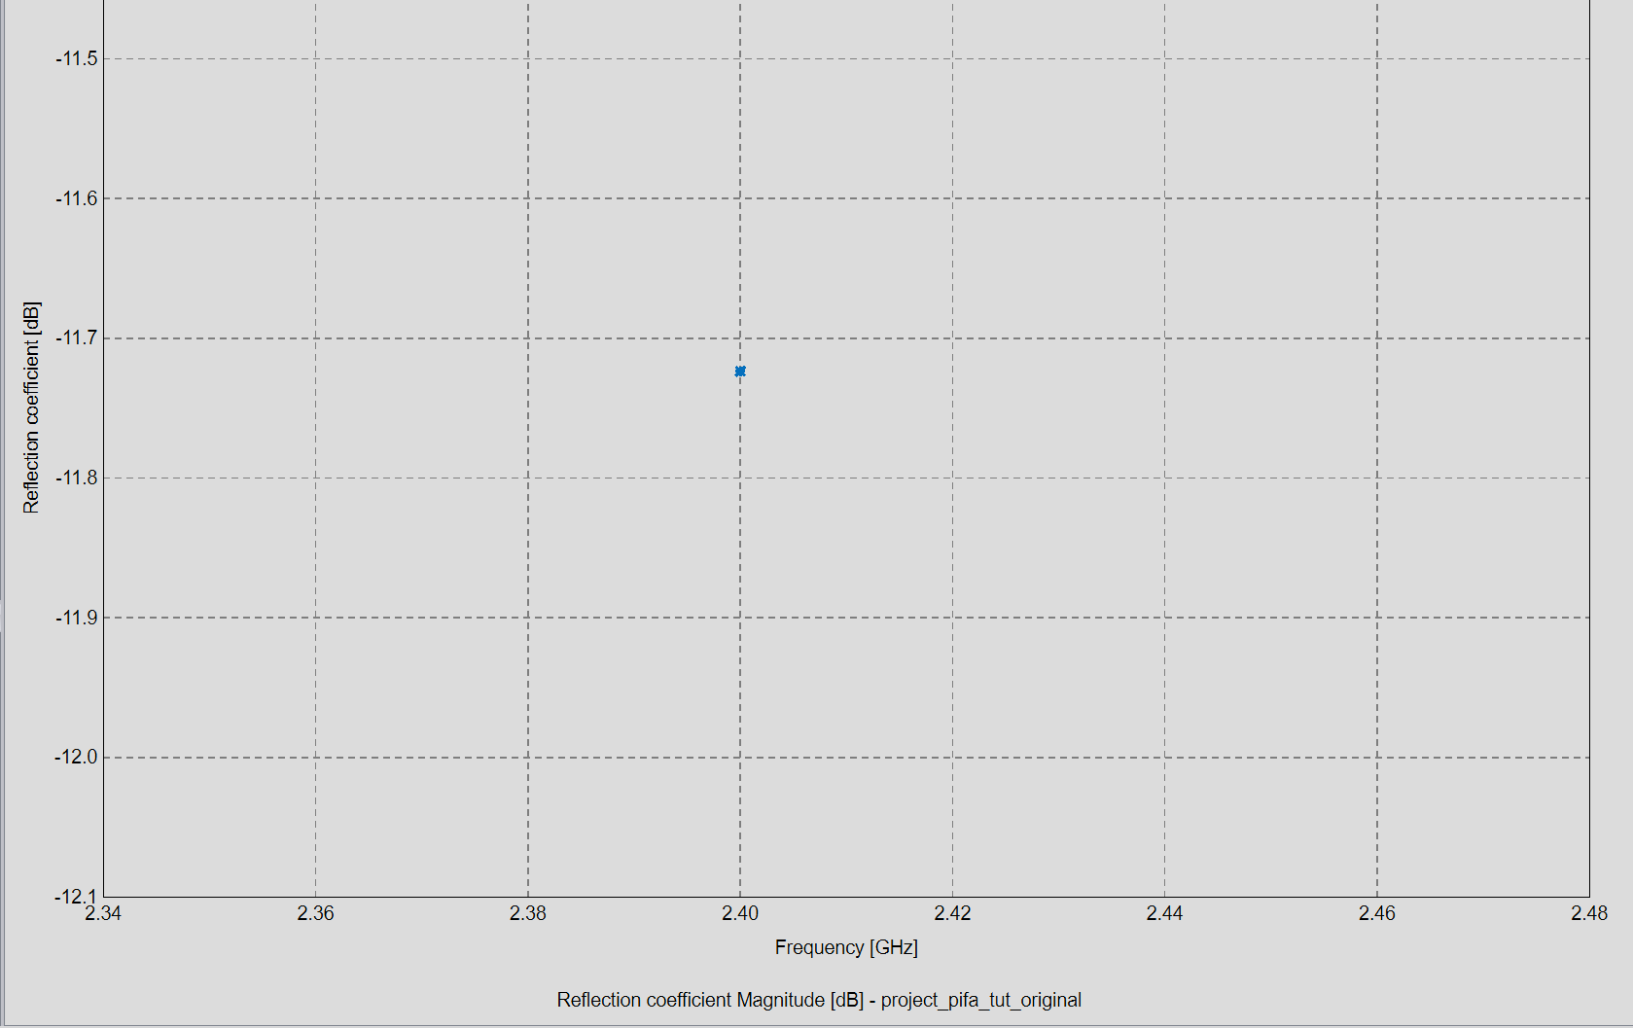
Muscle Sim Results -
Reflection Coefficient
At 2.4 GHz Reflection Coefficient is quite low.
A sweep was not performed because the model is too large to run many tests.

Slide 26
Sources
PIFA - Planar Inverted-F Antennas
https://www.antenna-theory.com/
https://www.sciencedirect.com/topics/engineering/monopole-antenna
https://www.5gtechnologyworld.com/demonstrating-antenna-diversity-part-2-the-pifa/
https://www.researchgate.net/figure/Schematic-diagram-of-the-PIFA-antenna_fig1_216605700
BLE-guide
https://pubmed.ncbi.nlm.nih.gov/35161734/
https://novelbits.io/bluetooth-low-energy-ble-complete-guide/
https://advanced.onlinelibrary.wiley.com/doi/10.1002/aelm.202400884?af=R
https://www.allaboutcircuits.com/technical-articles/exploring-the-basics-of-bluetooth-low-energy-a-beginners-guide-to-ble/#:~:text=Introduced%20in%202010%20as%20a%20part%20of,they%20used%20up%20too%20much%20battery%20power.
Electric Properties of Human Tissue
https://niremf.ifac.cnr.it/tissprop/htmlclie/htmlclie.php

